Slide 1
A Java Toolbox for Scalable Probabilistic Machine Learning
Rafael Cabañas
rcabanas@decsai.ugr.es
Toolbox tutorial
April 17th, 2017 Granada
Notes:
Norwegian University of Science and Technology

Slide 2
Requirements
Check your java version:
http://www.oracle.com/technetwork/java/javase/downloads/
$ java -version
https://www.jetbrains.com/idea/
Notes:
Notes:
$ java -version : note that there is only one dash ‘-’.
Explain that for making the toolbox work, we need Java8. But the IntelliJ IDEA is only needed for following this tutorial

Slide 3
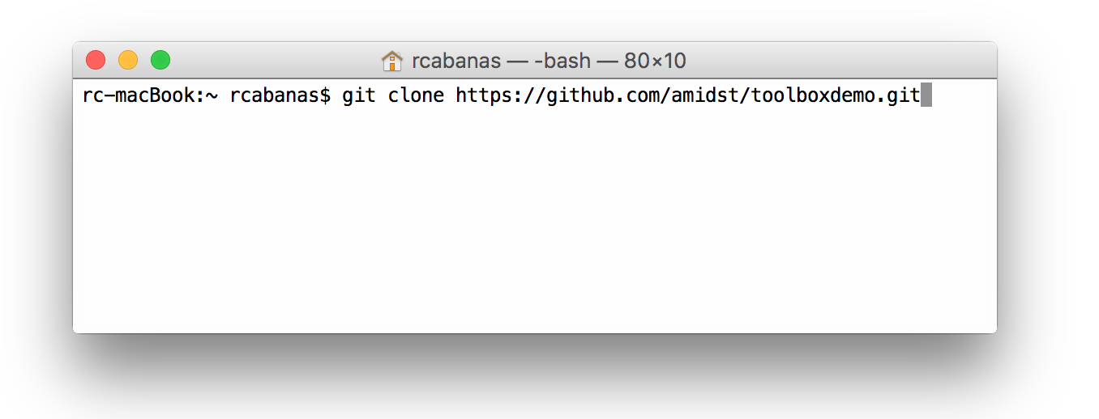

Example Project
Step 1: Download the material
Option A:
Option B: visit https://github.com/amidst/toolboxdemo and click on

Slide 4
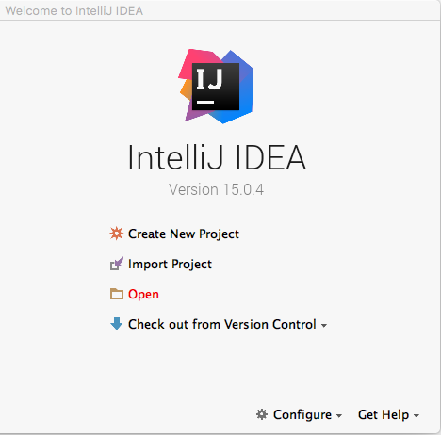
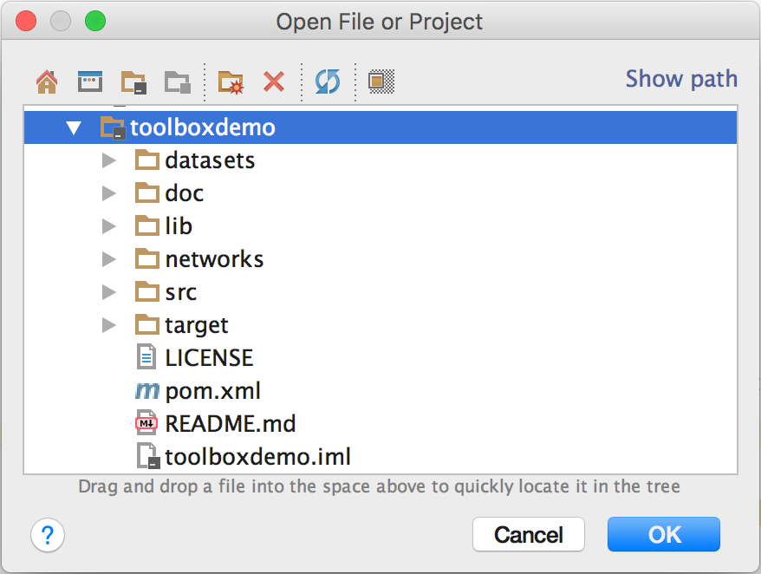
Example Project
Step 2: Open the downloaded project with IntelliJ:

Slide 5
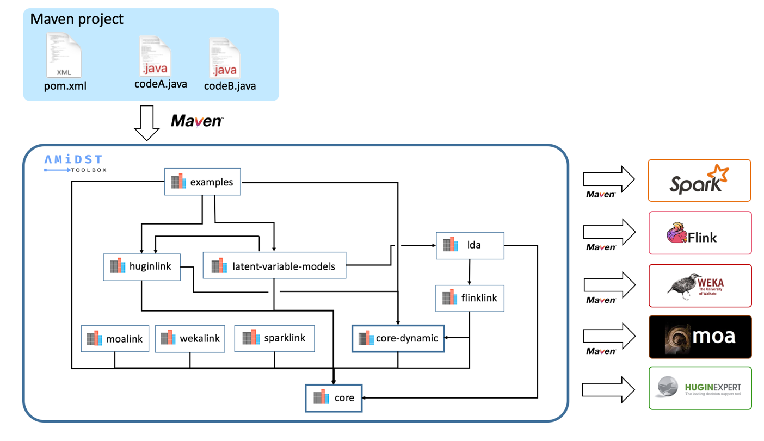
Overview

Slide 6
Overview
Explain example project

Slide 7

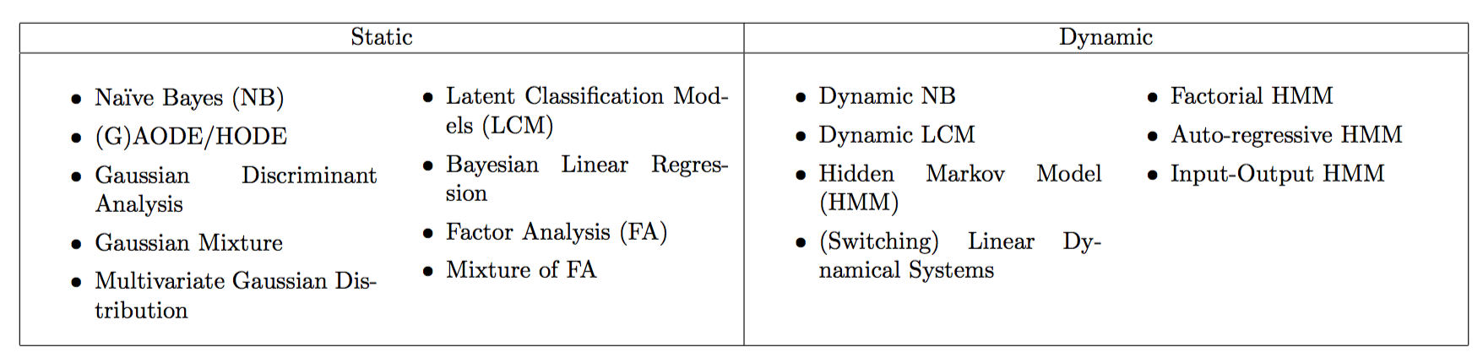
Predefined Models
Wide range of predefined models with latent variabels
Available in module

Slide 8
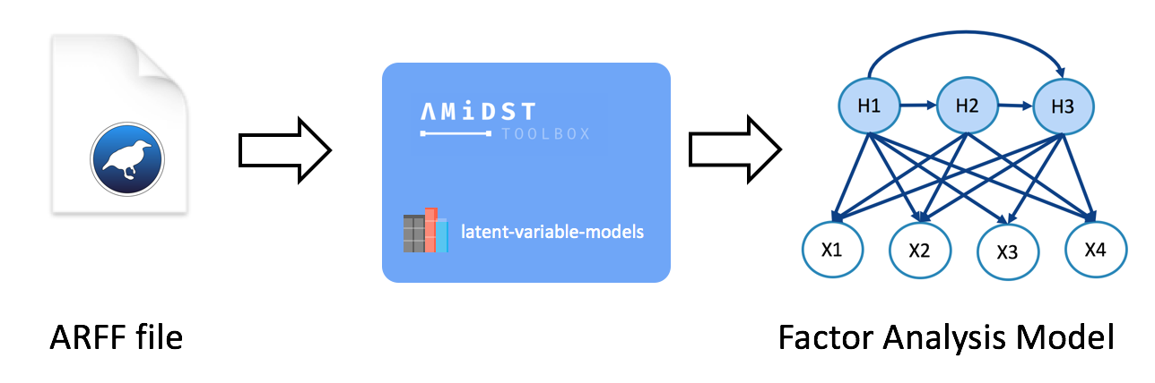
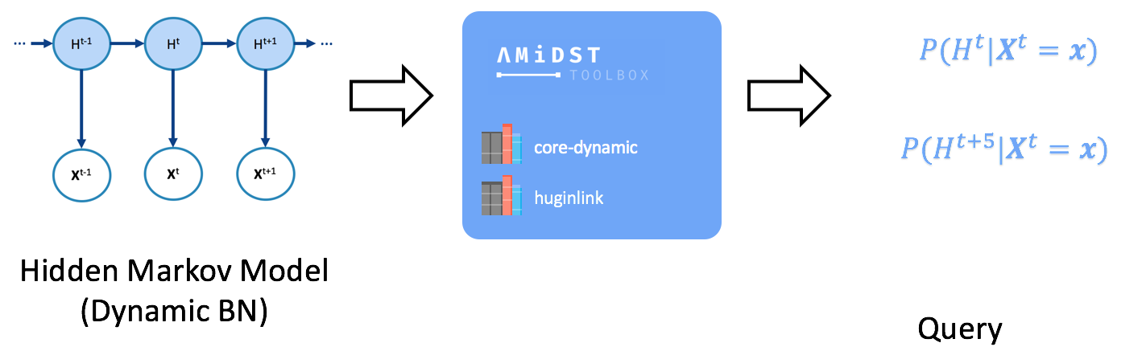
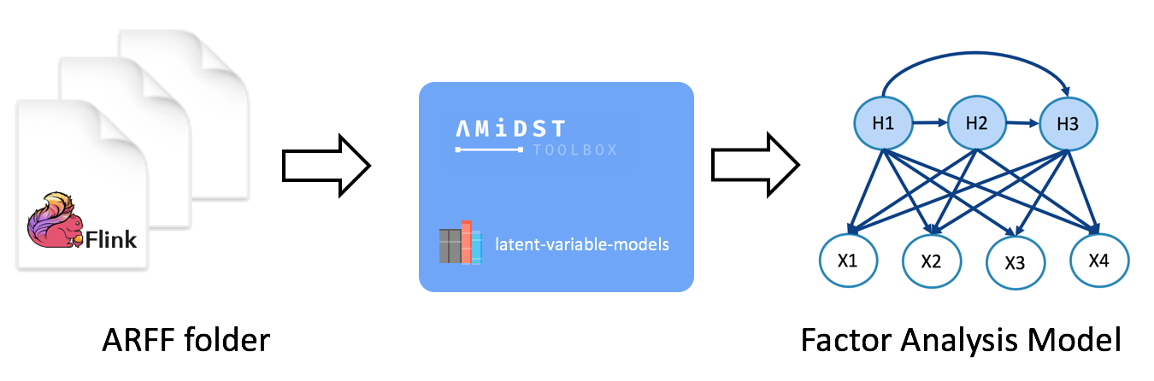
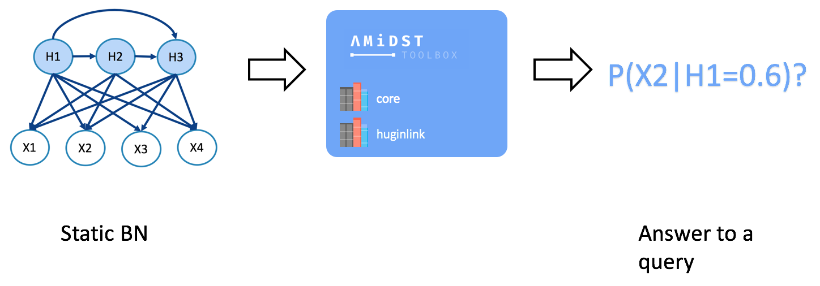
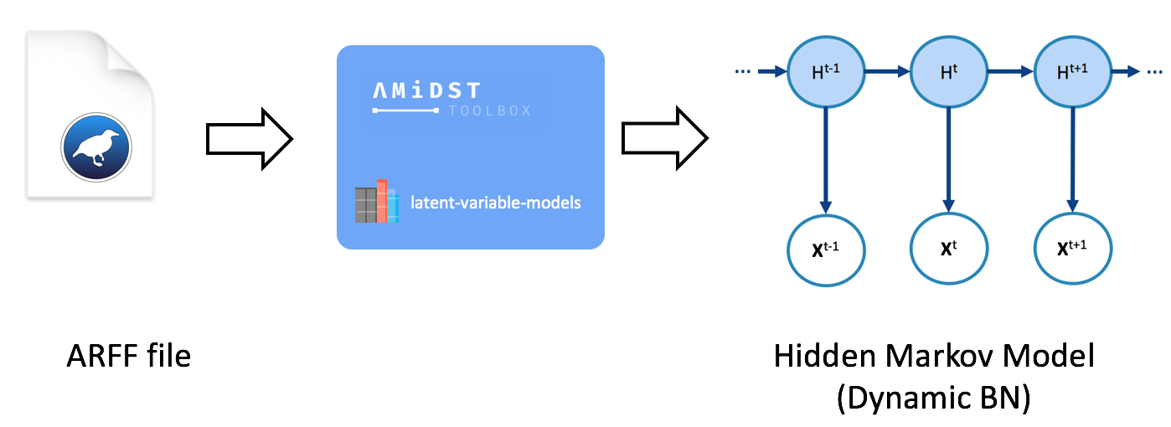
Code Examples
Learning
Inference
A)
B)
C)
D)
E)

Slide 9
Code Examples
Learning
Inference
A)
B)
C)
D)
E)
Explain code examples

Slide 10
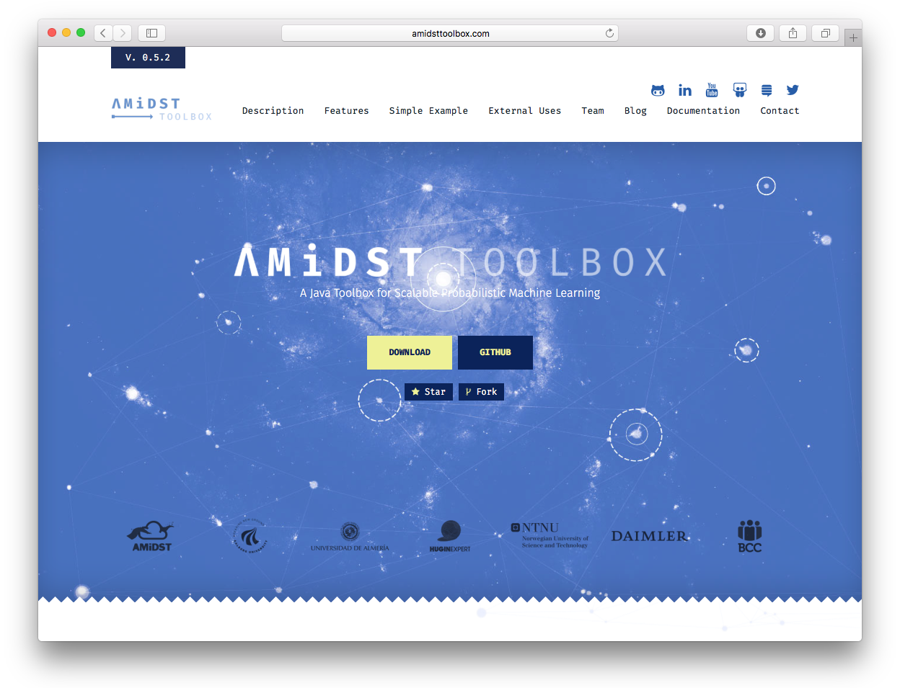
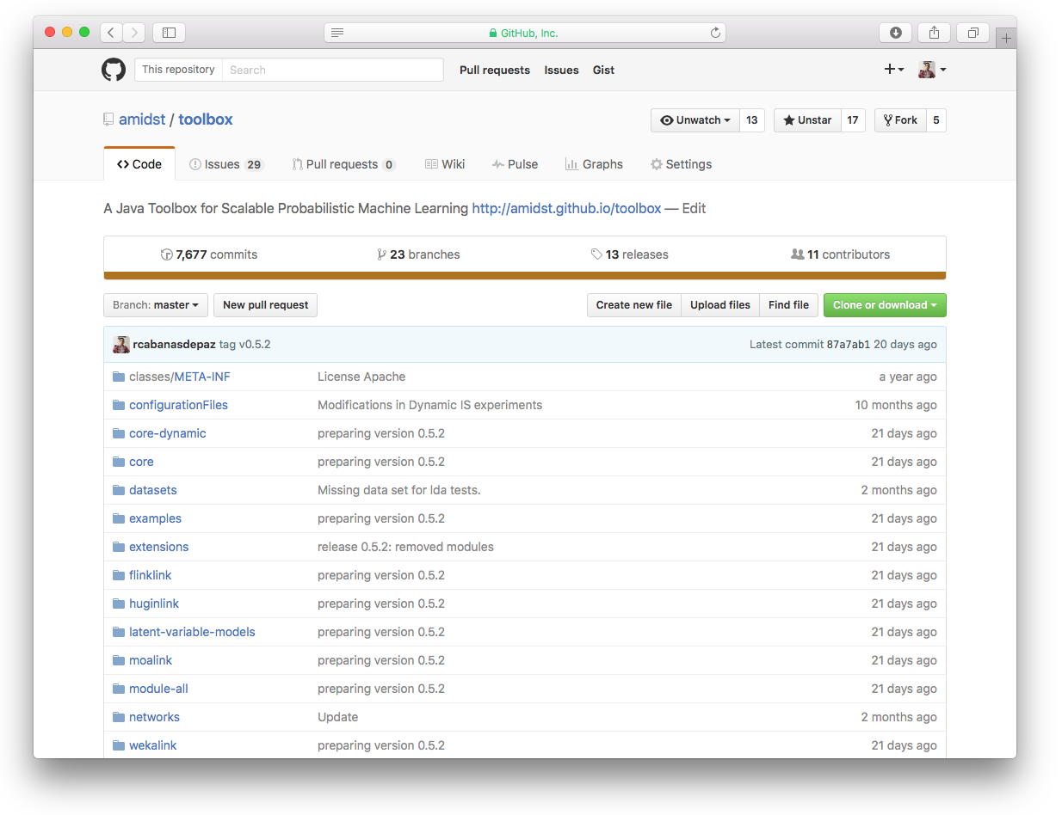
Collaborate
www.amidsttoolbox.com
github.com/amidst/toolbox
Appache
License 2.0
Unemployment Rate main driver of Concept Drift
Hidden Variable correlates with unemployment rate (rho = 0.961)

Slide 11


Thanks for your attention
www
www.amidsttoolbox.com
@
contact@amidsttoolbox.com
@AmidstToolbox

